Slide 1

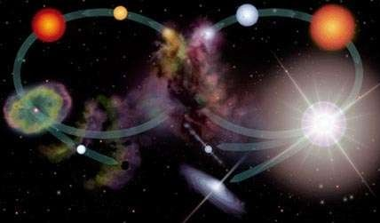
Life Cycle of a Star Formation of Stars

Slide 2












What are the stages of a star’s life?
Surprisingly!!
Life cycle of a star depends on how they start their life!!!!
High Mass
vs.
Low Mass

Slide 3

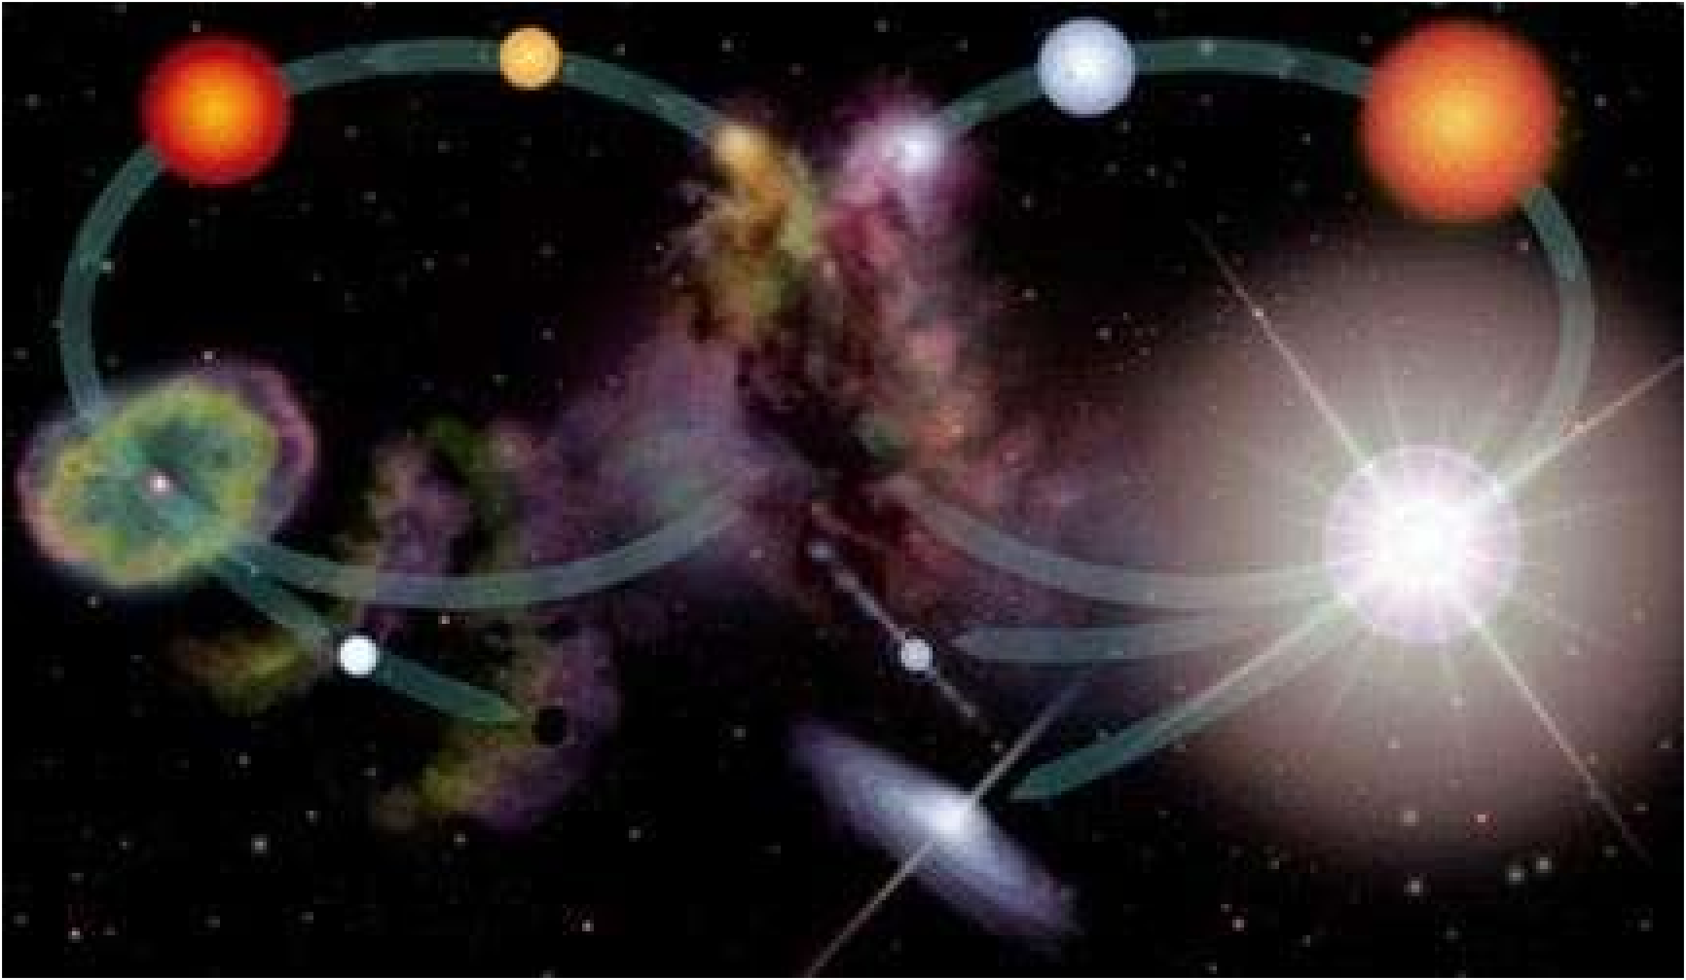


What are the stages ?
a: Low Mass Star b: High Mass Star
Red Giant
Main Sequence
Main Sequence
Red Supergiant
Planetary Nebula
Nebula
Supernova
Neutron Star
White Dwarf
or
Black Dwarf
Black Hole

Slide 4
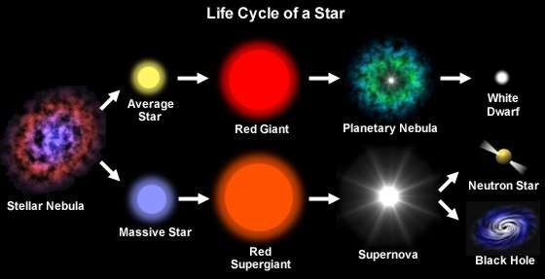
STAGES DISCUSSED SO FAR:

Slide 5
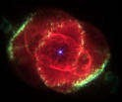
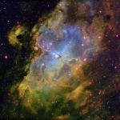

What happens during the stages?
Stage 1 – Nebula
A cloud of dust and gas
When the gas and dust contracts under gravity, a protostar is born

Slide 6
STAGES DISCUSSED SO FAR:

Slide 7
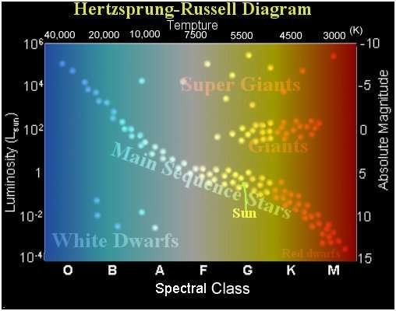
Stage 2 –Main Sequence
Incase of large Mass
Star reaches equilibrium (it’s stable)
Can last up to 10 billion years
Incase of small Mass
Can last less than 1 million years

Slide 8
STAGES DISCUSSED SO FAR:

Slide 9
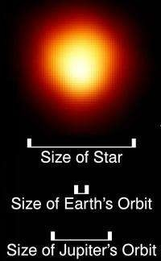
Stage 3 –Red Giant
Hydrogen in core is depleted
Core contracts and heats up
Heat causes the outer layers to expand
Expanding causes the layers to cool

Slide 10
STAGES DISCUSSED SO FAR:

Slide 11
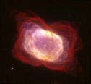
Stage 4 Planetary Nebula
All helium in the giant has fused into carbon
Core collapses again
Outer layers of star are expelled into space

Slide 12
STAGES DISCUSSED SO FAR:

Slide 13

Stage 5 White Dwarf
Core contracts even more
More layers expelled into space
Leaves behind only a hot, dense core (about the size of Earth)

Slide 15
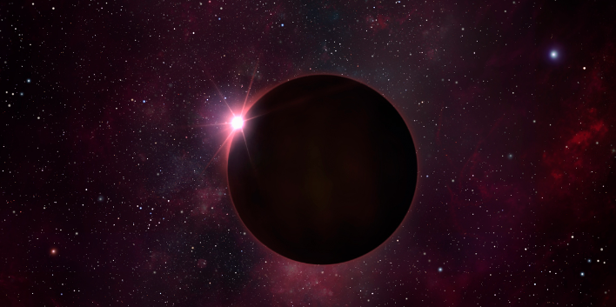
Stage 6 Black Dwarf
A non-radiating ball of gas where fusion has ceased.
This was the trajectory of life of a star with relatively SMALL Mass…

Slide 16
STAGES DISCUSSED SO FAR:

Slide 17
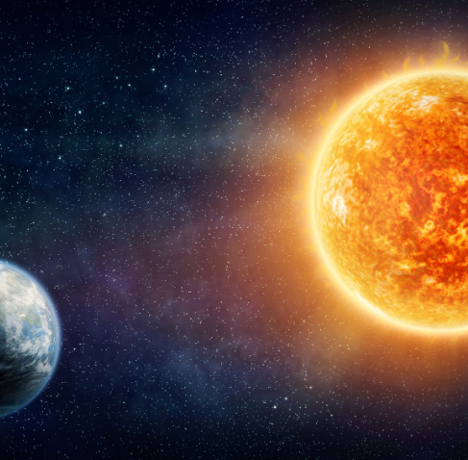
Let’s follow along the life cycle of a start with LARGE Mass By discussing in details of life cycle of our personal star… OUR SUN!!!

Slide 18
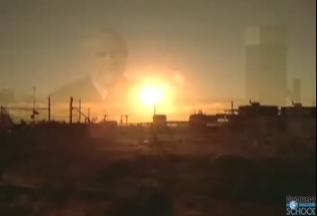
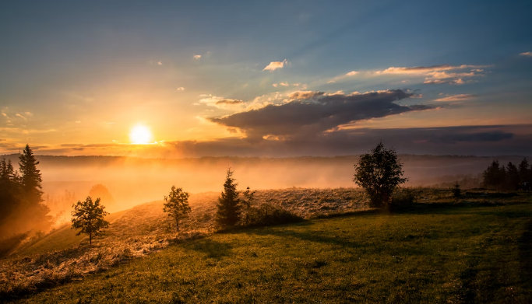

Slide 19
The initial stages
Stage 1: Nebula (a cloud of dust and gas) -> Protostar
Stage 2: Main Sequence (can last up to 10 billion years for large mass stars and up to 1million years for small mass stars)
The initial stages are essentially the same for all stars irrespective of their mass

Slide 20
STAGES DISCUSSED SO FAR:

Slide 21
Stage 3: Red Supergiant
Hotter, larger and more orange than a red giant

Slide 22
STAGES DISCUSSED SO FAR:

Slide 23
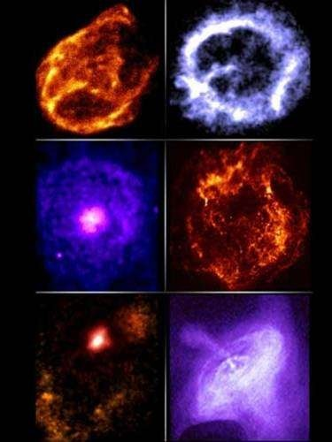
Stage 4: Supernova
All of the helium in a supergiant has fused into iron
The core collapses
violently
The outer portion of the star explodes
Very Bright!!!!

Slide 24
STAGES DISCUSSED SO FAR:

Slide 25
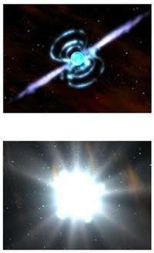
Stage 5: Neutron Star
If the core of a supernova has 2 times more mass than the sun;
The core shrinks to 20 km in diameter
Only neutrons can exist there
1 tsp = 100 million
tons

Slide 26
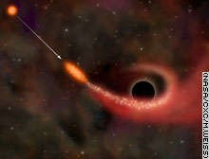

Stage 5: Black Hole
If the core of a supernova has 3 times more mass than the sun;
Core collapses to the point that It has no volume
Gravity is so strong that nothing can escape, not even light

Slide 27
YAYY!!
WE CAN COMPLETELY UNDERSTND THE FOLLOWING STAGES:

Slide 28
SUBMITTED BY :
ASTHA RAGHUWANSHI 21103042 B2
PRERNA 21103043 B2
JAHANVI GUPTA 21103150 B6

